Slide 1
DIGITAL WATCHMAN USING DEEP LEARNING
Team 10:
V.Likitha (21EG505870)
G.Sairam (21EG505828)
J.Dayamani (21EG505831)
Project Supervisor
Dr. P. Ravinder Rao Assistant Professor

Slide 2
Introduction
Security and safety is a big concern for today’s modern world. In today’s insecure world the video surveillance plays an important role for the security of the indoor as well as outdoor places. This hierarchical technique detects various suspicious activities such as loitering, fainting, illicit access. If detected, it sends an alert message to the concerned authorities. By this we can protect our society from harmful or dangerous activities.
Applications: Retail stores, Banks and ATMs, Airports and Transportation Hubs, Smart Cities , Schools and Campuses, and in Parking Lots.

Slide 3
Literature
Author(s) | Method | Advantages | Disadvantages
Amrutha, Jyotsna, Amudha (2020) | CNN, RNN,LSTM | This paper provides accuracy of the training phase is 76%. | This paper is limited of academic and campus area only.
U.M. Kamthe, C.G.Patil (2018) | CNN, RNN,LSTM, GMM (Guassian Mixture Model) | This research paper provides 93% accuracy in detection of Loitering at ATM. | Objection detection is complex such as low light, multiple objects in the image might be blurred.

Slide 4
Problem Statement
Develop an intelligent system for detecting suspicious activity in real-time video streams to enhance security as human cannot monitor every particular person , what he is doing in a specific situation.
Objective
The primary objective of this project is to implement a system which detects suspicious activities and weapons in video surveillance data. We use deep learning algorithms, specifically Convolutional Neural Networks (CNN), Long Short-Term Memory networks (LSTM), Recurrent Neural Networks (RNN), Gaussian Mixture Models (GMM).

Slide 5
Proposed Method
Our proposed system of Digital Watchman aims to develop an accurate model for detecting suspicious activities in real-time video surveillance data using deep learning algorithms (CNN, LSTM, RCNN, GMM) and to generate timely alarms when such threats are identified.
Methodology:
1) Data Collection and Preparation: Describe the data sources, such as surveillance cameras and datasets, used for training and testing.
2) Deep Learning Models:
CNN: Emphasize its role in spatial feature extraction.
LSTM: Highlight its use for modeling temporal dependencies.
RNN: Describe its object detection capabilities.
GMM: Explain its role in statistical modeling of weapon appearances.
3) Combine outputs from all models.
4) Detection and Alerting: Generate real-time alerts with information on location, timestamp, and threat descriptions.
5) Alert Delivery : Delivering alerts and managing alerts.

Slide 6
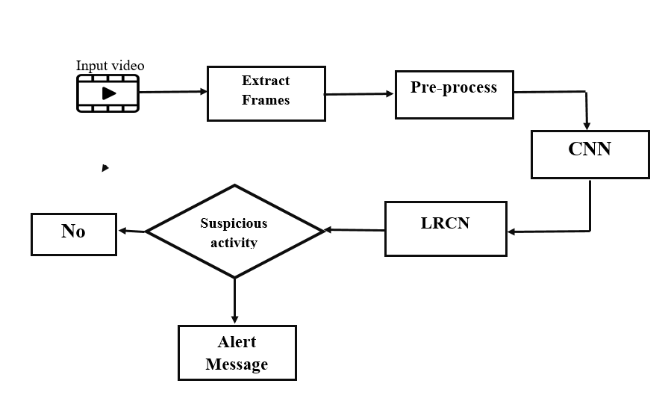
Proposed Method

Slide 7
Project status
S.No | Functionality | Status (Completed /in-progress/Not started)
1. | Exploring IEEE papers | Completed
2. | Abstract | Completed
3. | Datasets | In Progress
Note: Submit Form 1,2 and 3

Slide 8
References
Amrutha C.V, C. Jyotsna, Amudha J. “Deep Learning Approach for Suspicious
Activity Detection from Surveillance Video” Dept. of Computer Science & Engineering, Amrita School of Engineering, Bengaluru, Amrita Vishwa Vidyapeetham, India.
Ms.U.M.Kamthe, Dr. C.G.Patil “ Suspicious Activity Recognition in Video Surveillance System” Dept. of E & TC SAE, Pune, India.

